Slide 1

Police Complaint Management System using Block Chain
Presented By Name: bIndubhargavi Pallreddy
Major: Masters in computer science – (web development)
Sid:(b00114062)

Slide 2
Abstract
In general, criminal activity is increasing over the globe. Reports of several of these incidents are lacking. While the police do have an online platform for both sorts of reports, the majority of first information reports(FIRs) are written by hand.
For a resilient system and secure complaint handling away from inspectors, a decentralized solution is necessary. We intend to offer a blockchain-based solution for the management of complaints about both proper and unacceptable offenses.
The police-filled FIR will be accompanied by additions to the blockchain network, encryption, and IPFS storage.
The changes can be easily tracked before presenting the FIR to the court. If the police Officer does not file the FIR because of pressure or claims not to have received the complaint, the timestamp and complaint itself would be admissible as proof because they were recorded on the blockchain network.

Slide 3
Existing System
A database management system (DBMS) deployed online for handling customer complaints.
An efficient and successful way for law enforcement agencies and related organizations to manage and process public complaints is through the use of police complaint management systems.
Although the current systems may differ from one region to another, they usually have several similarities. The following is a rundown of some of the most important features and components of a current police complaint management system:
A Police complaint management system’s precise features and functionalities can differ greatly based on factors such as the budget, the size of the police force, and the region in question.
More complex techniques, including data analytics and artificial intelligence, may become available as technology evolves, which could further improve complaints management procedures.

Slide 4
Advantages:
1. Centralized Control:
Traditional Databases are usually centralized, emphasizing that they are governed by a solitary institution or group. The process of centralization might result in the existence of unique points of failure and vulnerabilities.
2. Data Manipulation:
In conventional databases, users with the necessary permissions can simply modify or change data. These circumstances can result in data corruption, fraudulent activities, or unauthorized entry.
3. Lack of Transparency:
Conventional databases may lack transparency, hence impeding the ability to track the chronological sequence of data modifications. This issue can be a challenge in applications that require utmost importance on the accuracy and openness of data.

Slide 5
4. Security Vulnerabilities:
Conventional databases are susceptible to hacking and cyberattacks. In the event of a breach in a centralized database, there is a potential for a significant data breach to occur.
5. Costly Intermediaries:
Conventional databases frequently necessitate the involvement of intermediaries such as banks or clearinghouses to authenticate and handle transactions, resulting in increased expenses and time consumption..

Slide 6
Proposed System
While the blockchain does have certain benefits, it’s important to remember that its not a solution and won’t work for every problem. Adoption is still in its early stages across many companies, and it may be slower and more resource-intensive than conventional databases. Before choosing to employ blockchain technology, it is important to carefully assess the project’s particular demands and objectives.

Slide 7
Advantages:
1. Decentralization:
Blockchain reduces the danger of single points of failure and enhances resilience by operating on a decentralized network of nodes.
2. Immutability:
Data stored on a blockchain cannot be altered or deleted because of its immutability. Data integrity and trust are both improved by its immutability.
3. Transparency:
All the transactions recorded on a public blockchain are open and verified. In fields where honesty and reliability are paramount, this openness can be an important factor.

Slide 8
4. Security:
Blockchain utilizes robust cryptographic methods to safeguard data and transactions, rendering it very impervious to hacking and fraudulent activities.
5. Reduced Intermediaries:
Blockchain technology eliminates the necessity of agents in numerous instances, resulting in cost reduction and acceleration of procedures. This is especially beneficial in financial transactions and supply chain management.
6. Trustless Transactions:
Blockchain enables participants to engage in transactions without relying on a central authority for confidence. Trust is established by the intrinsic characteristics of the blockchain.

Slide 9
7. Smart Contracts:
Blockchain can carry out self-executing smart contracts, which are automated and enforce contractual agreements without the involvement of agents.
8. Global Accessibility:
Blockchain networks have a worldwide reach and can be accessed by anybody with an internet connection, enabling transactions and collaborations across different countries.

Slide 10
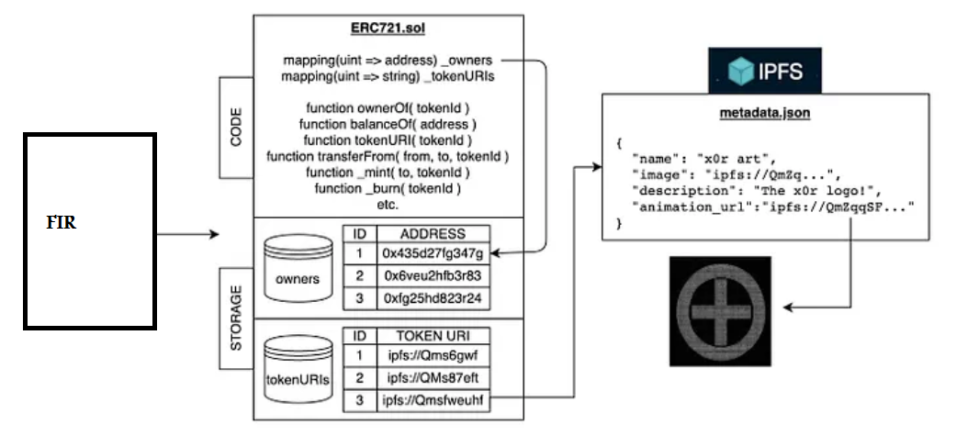
Structure of Non-Fungible Token:

Slide 11
Project Modules:
1. Admin Page :
Login
Approve User
Approve Complaint
Status of Complaint

Slide 12
2.Citizen :
Registration : username, password, email, mobile, Passport no
Login
Dashboard
Complaint Creation
Complaint withdraw.
Email-Notifications.

Slide 13
3. Police :
Registration: username, password, email, mobile, Passport no, designation, station code.
Login
Dashboard
Schedule
Complaint Submission ( Assign to Lawyer)

Slide 14
4. Lawyer Page :
Registration: username, password, email, mobile, Passport no, designation, station code.
Login
Lawyer’s Dashboard
View complaints
Scheduled
Close case

Slide 15
5. Citizen/User/Victim :
Registration: username, password, email, mobile, Passport no, designation, station code.
Login
Dashboard
File Complaint
Withdraw case

Slide 16
Block Chain Modules:
Blockchain: A distributed ledger system is the basis of blockchain technology. Decentralization, security, transparency, and immutability are just a few of the advantages it offers. It is the bedrock upon which NFTs and IPFs rest.
Non-Fungible Tokens (NFTs): The term: Non-Fungible Tokens”(NFTs) refers to unique assets that represent the right to use a certain piece of content, digital collectible, or physical good. Their ability to prove the provenance and ownership of digital assets is a major reason for their meteoric rise in popularity across many industries, including the arts, gaming, and entertainment. Blockchain platforms like Ethereum are ideal for building NFTs, which use smart contracts to define their properties and ownership rules.
Interplanetary File System (IPFS): IPFS is a decentralized and distributed file storage system specifically created to address the constraints of conventional centralized servers. The system has a content-addressable architecture, which greatly enhances its resilience against both data loss and censorship. IPFs offers a decentralized and peer-to-peer method for storing and accessing data, which reduces dependence on centralized servers and enhances data availability.

Slide 17
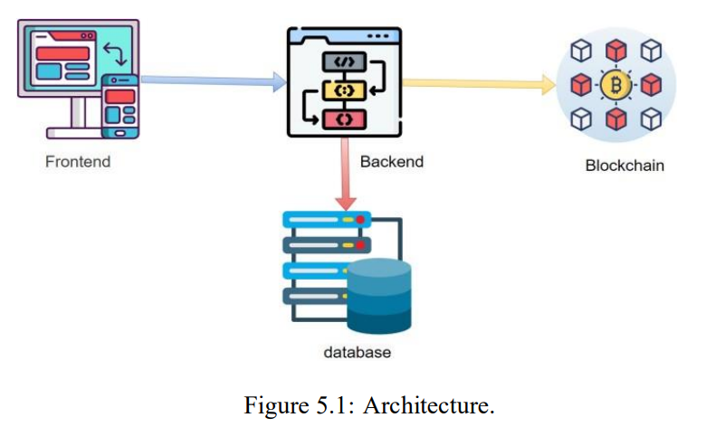
System Architecture
The architecture of the "Blockchain-based Police Complaint Management System" consists of four primary components: frontend, backend, blockchain layer, and database. Now, let's analyse the structure of the model.

Slide 18
1. Frontend :
The front end functions as the interface through which users submit and monitor complaints. Facilitates device-independent accessibility to ensure a positive user experience. Complaints are submitted, their status is monitored, and citizens can communicate with law enforcement via the front end. For complainants to have a seamless experience, the system must be accessible across devices and user-friendly.
Backend :
Executes user requests and oversees the movement of data. Enables the exchange of information between the front end and other components of the system. The backend handles user requests, manages data flow, and facilitates communication between the front end and other system components. Features such as complaint validation and notification management guarantee effective complaint handling.

Slide 19
3. Blockchain Layer : Employs blockchain technology to achieve decentralized and tamper-proof storage. Documents grievances as individual transactions, guaranteeing openness and accuracy of information. The blockchain layer uses blockchain technology to securely store and oversee complaint recordings in a decentralized and tamper-resistant way. Every complaint is logged as a transaction on the blockchain, guaranteeing transparency, unchangeability, and the integrity of data.
4. Data Base:
The primary purpose of this system is to store supplemental data and serve as an intermediary between the blockchain and the backend. Includes user profiles, metadata that meets compliance standards, and administrative records. In addition, the database stores additional data and serves as a connection between the blockchain layer and the backend. The data includes user profiles, compliance metadata, and administrative records. Integrating with the blockchain layer guarantees that the database and the unchangeable blockchain ledger are synchronized and consistent.

Slide 20
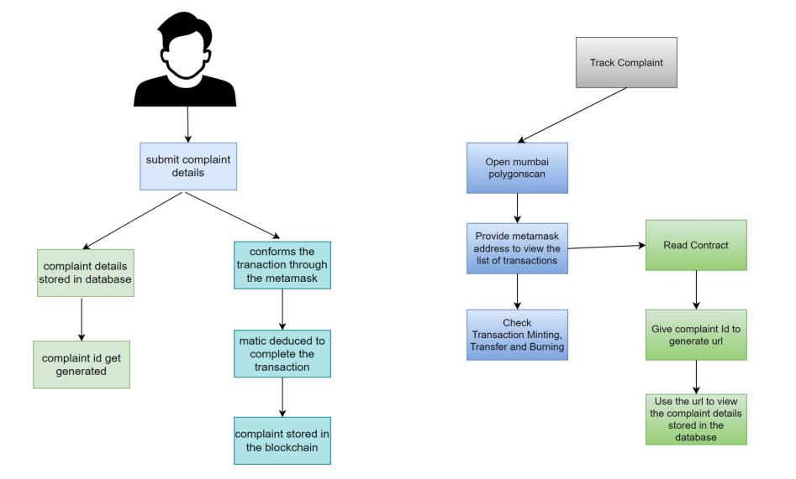
Complaint Tracking & Storage Process:

Slide 21
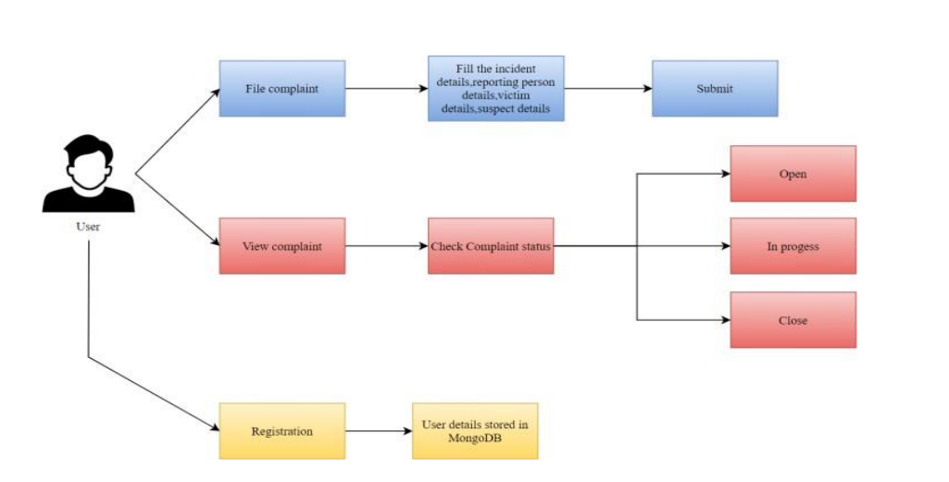
Functionalities of citizen:

Slide 22
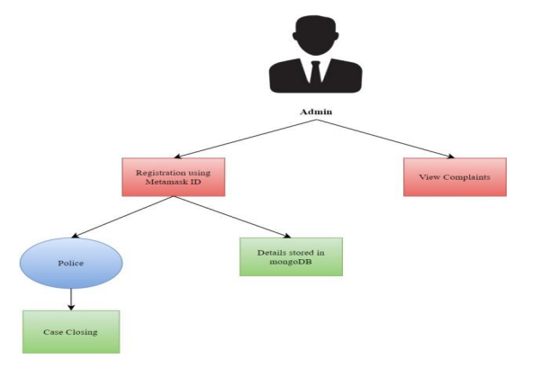
Functionalities of Admin:

Slide 23
Network: Ethereum Sepolia ETH
How to get Sepolia Testnet :
Network Name : Sepolia Testnet Network
URL Link: https://sepoliarpc2.sepolia.org
Chain id: 11155111
Currency symbol: Sepolia ETH
Block Explorer: https://sepolia.etherscan.io/

Slide 24
Addresses Used :
MetaMask address: 0x8452aDfCC7DA51c96dB0C8A61159Cb054299B737
Blockchain Deployed smart Contract address: 0xb1d85f3D5DafD905D61CF8e588A82d8dbfF0A41A
Contract address link: https://sepolia.etherscan.io/address/0xb1d85f3D5DafD905D61CF8e588A82d8dbfF0A41A

Slide 25
1.Frontend code: localhost:3006/home/ 2. I used “npm start” to start the React server.
3. To start the backend server, I used “Netlify dev”.
4. Backend code: localhost:8888/

Slide 26
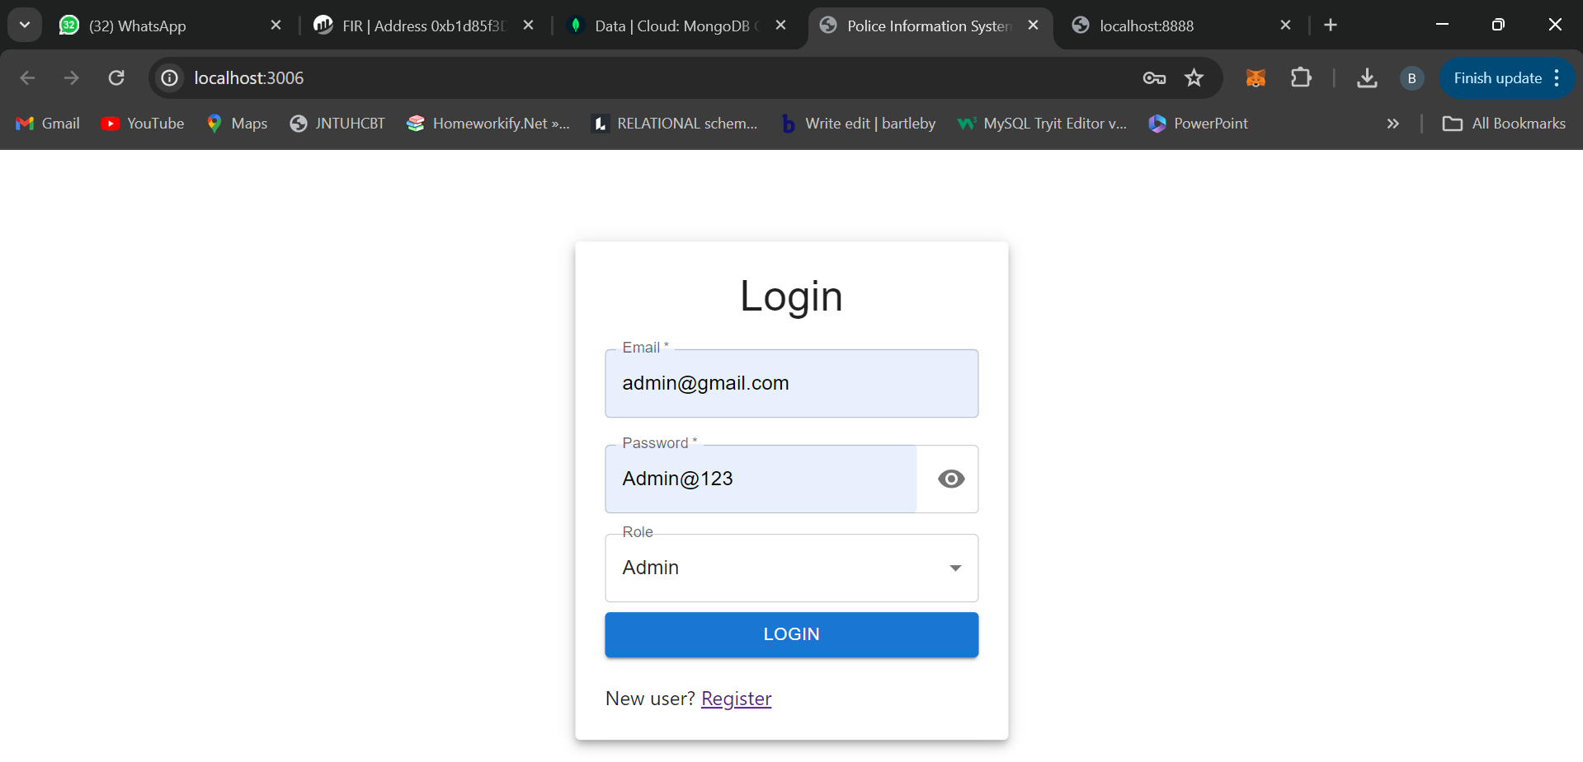
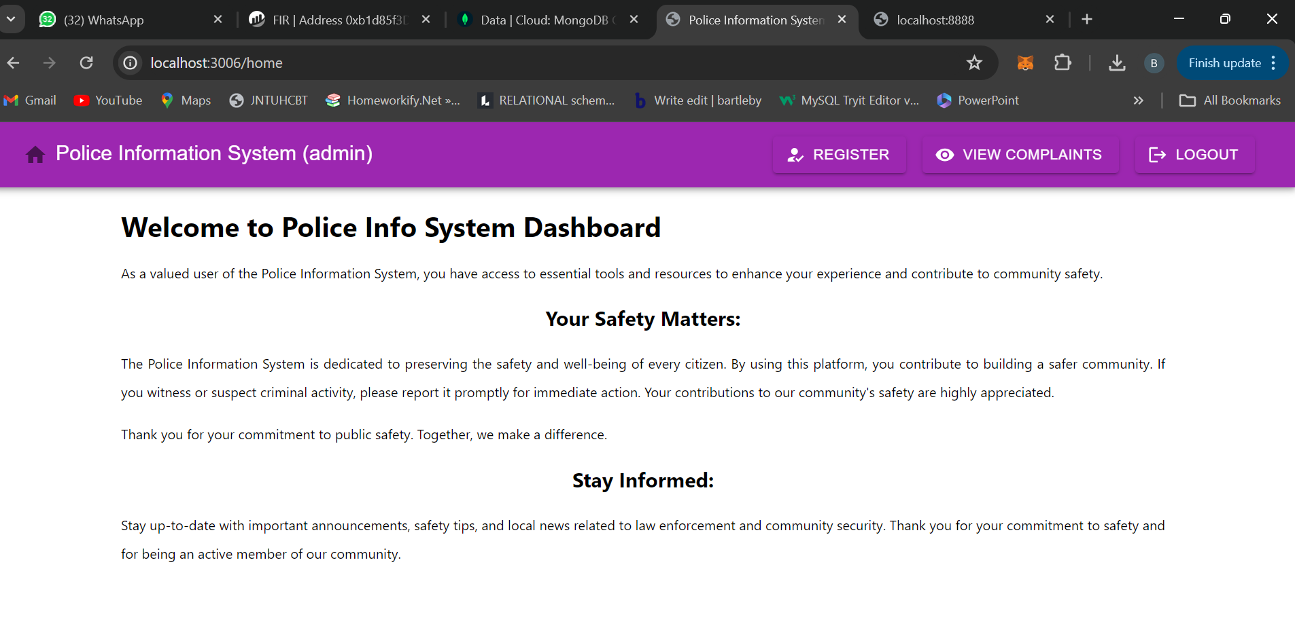
OUTPUT SCREENSHOTS:
Output 1: Login and Dashboard Page

Slide 27
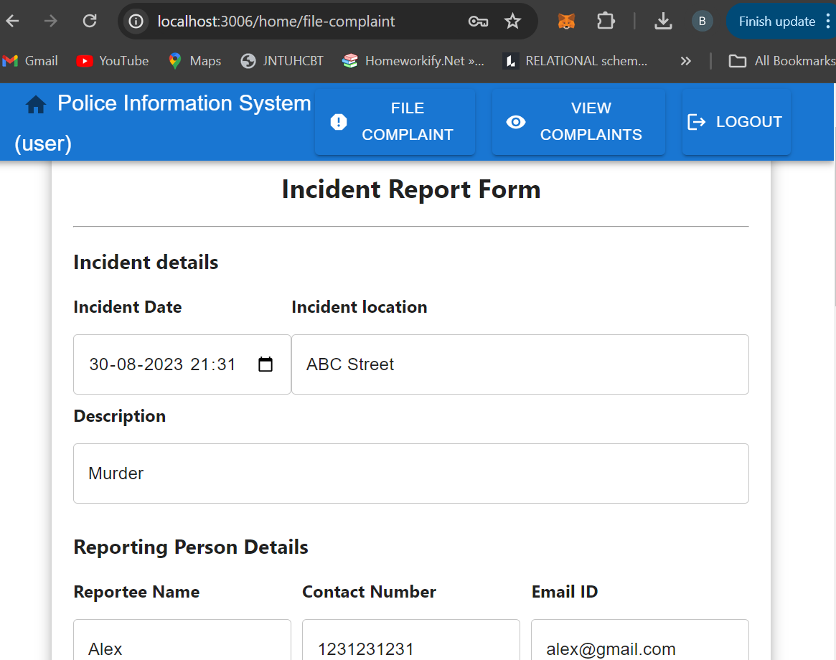
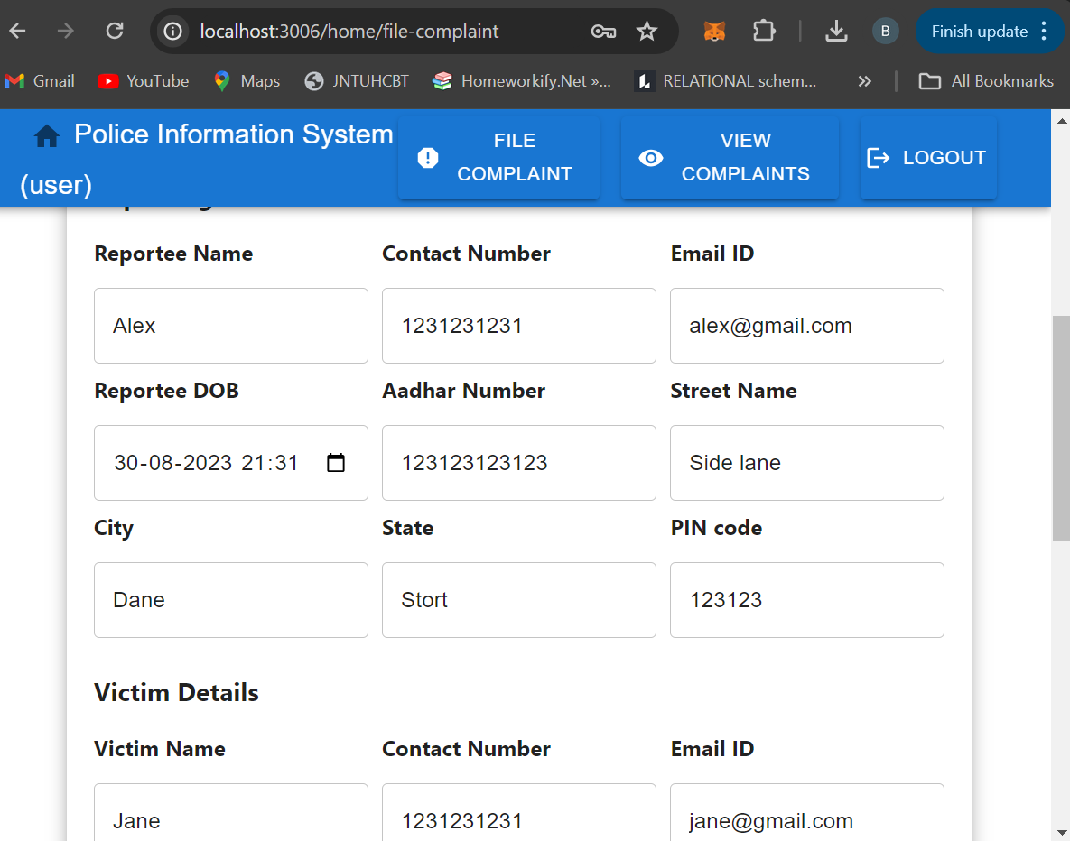
Output: file a complaint
Output 2:

Slide 28
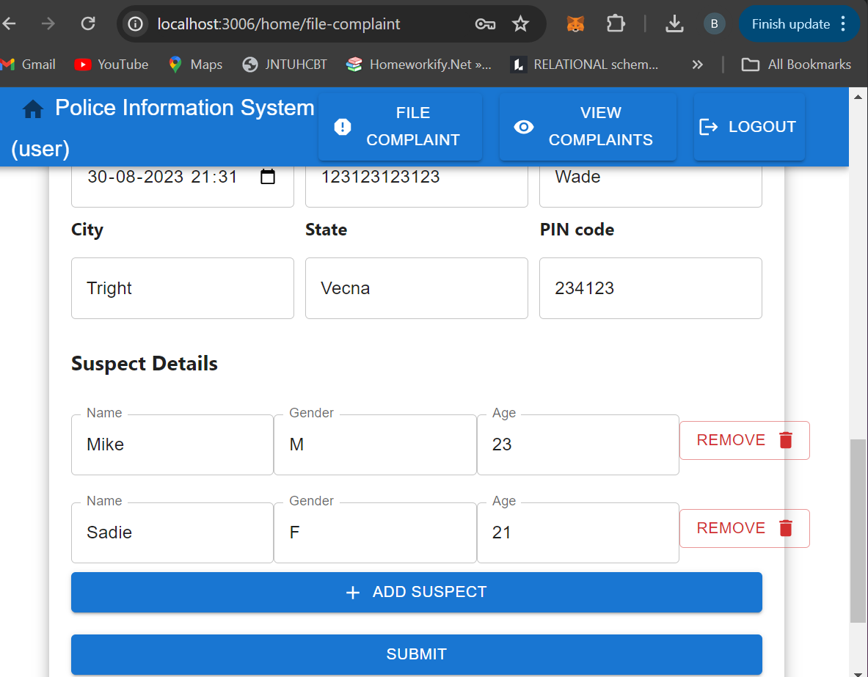
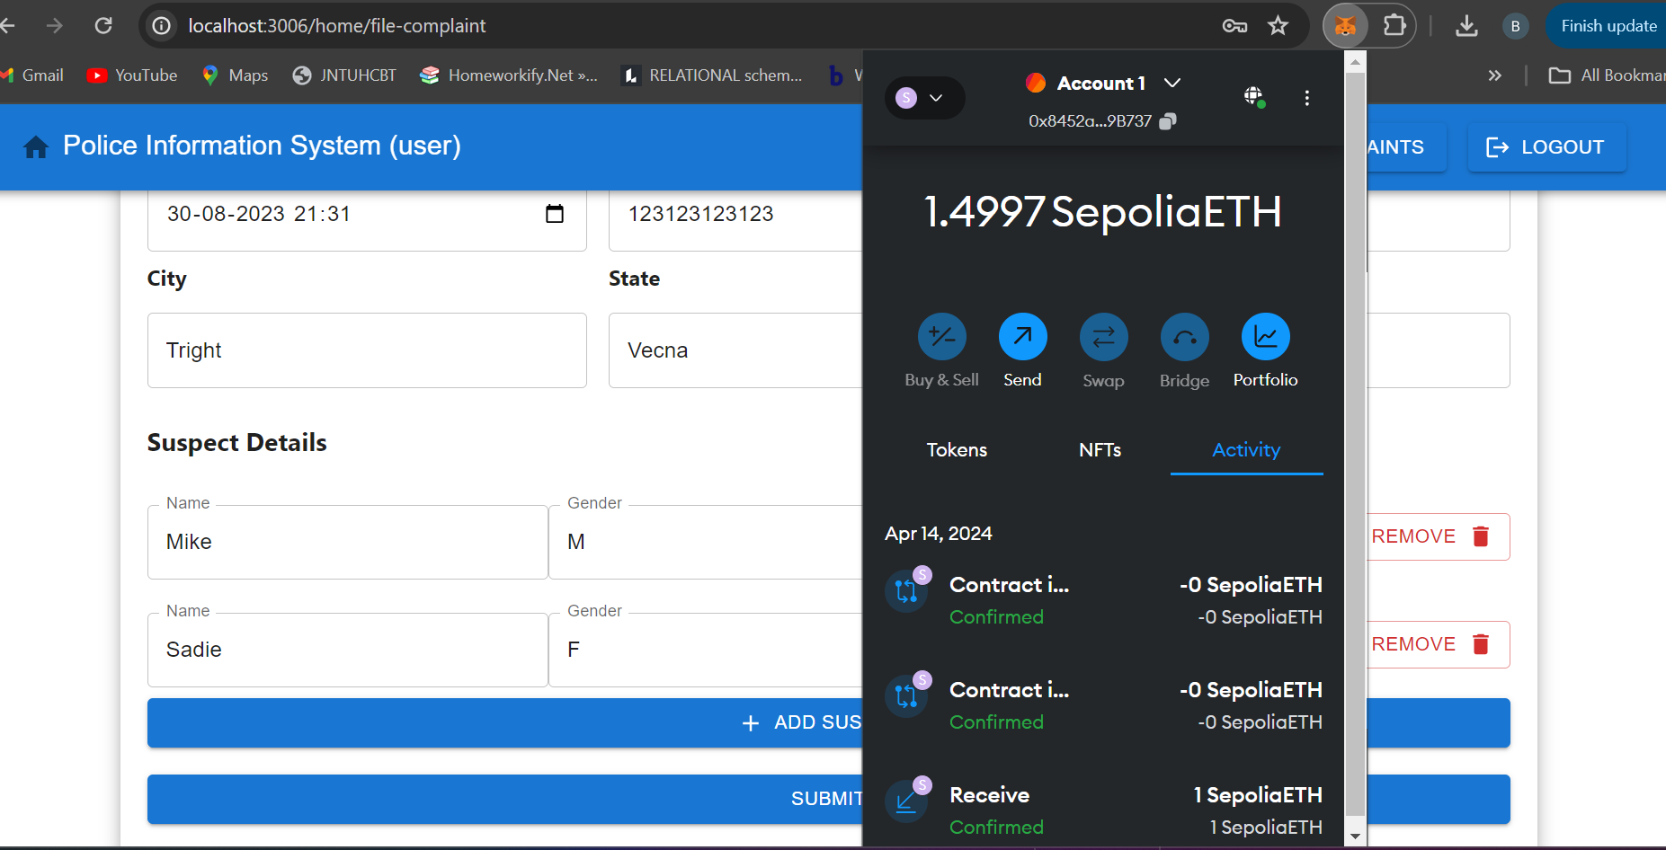
Output: Payment & Gas View
Output 3:

Slide 29
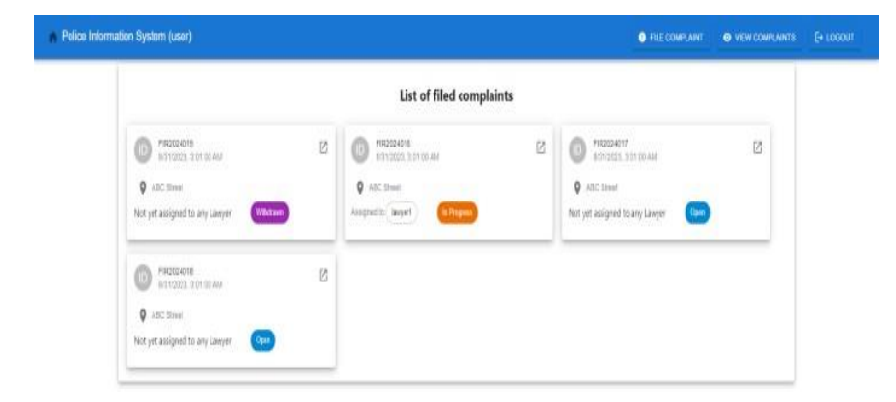
Output: List of Complaints
Output 4: 1. Open 2. In Progress 3. Closed 4. Withdraw

Slide 30
Conclusion:
When combined, NFTs and IPFs offer a full package for managing digital asset ownership and distribution. In contrast, IPFs, which maintain the actual digital content linked with NFTs and IPFs, stand for ownership of the asset. Unique, verifiable, and decentralized digital objects, artwork, and other assets can be made possible by combining these technologies. For reasons of security, the FIR details that citizens have submitted will not be changed.
The implementation of this project has led to the conclusion that NFTs, which allow for the production and trade of unique digital assets, are built upon blockchain technology. IPFs provide a decentralized and robust storage solution for the digital content that is part of this ecosystem, which makes it more complete. The convergence of these technologies is revolutionizing our understanding of digital ownership, provenance, and distribution in fields as diverse as art, gaming, media, and more.
Yet, it is crucial to be aware of the environmental implications and scalability obstacles linked to blockchain technology, as these matters persist as topics of discussion and advancement in the field.

